Slide 1

Sharing app
OpenHack Gothenburg 2018
Team: fiercemob
Moritz Denke, Mahmoud Hurria, Ara Jafarzadeh, Aswin Kumar Nagarajan, Martynas Lekeckas, Aron Sai

Slide 2
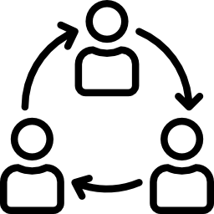

How did we spend our weekend?
Aim
Support sharing within trusted communities
Contribution
Showcase OS tools to make it happen, quickly
Icons made by mynamepong and eucalyp from www.flaticon.com

Slide 3
Demo

Slide 4


What should be done next?
User Experience
Incentive System
Intuitive communities
No feeling of bureaucracy
Feeling of trust
Points for sharing and for borrowing
Community leaderboard
Real world rewards
Icons made by freepik from www.flaticon.com

